Slide 1

RESEARCH PROGRESS REVIEW on “Learning Over Encrypted Data Using Machine Learning” 1th Review Presentation 29th March 2019
PRESENTED BY HEMANT RAMDAS KUMBHAR, Research Scholar(2017-18) 14th Batch, CSE Department, KLEF, Vaddeswaram, Guntur, Vijaywada, India | SUPERVISOR DR. S. SRINIVASA RAO Professor, CSE Department, St. Martin’s Engineering College, Dhulapally, Near Kompally, Secundarabad India

Slide 2
CONTENTS
Introduction
Need
Literature Survey
Problem Statement
Research Objectives
Methodology
Research Plan
Conclusion
Referemces

Slide 3
Introduction
The application of cloud-oriented services has increased from personal use such as mailing systems to the medical field.
Typically, a cloud service provider offers encryption services of sensitive data. However, decrypting the sensitive data in the cloud for data analysis using machine learning can lead to privacy concerns.
To this end, learning over encrypted data without decrypting it is the need of the future.
In this presentation, we present a holistic review and summarize the literature on “Expertise Learning Over Encrypted Data Using Deep Learning” containing homomorphic encryption, related issues, applications in machine learning over encrypted data, and potential future research directions.

Slide 4
2. Need of Expertise Learning Over Encrypted Data Using Deep Learning
As use of cloud services increasing tremendously.
Privacy of data over cloud is one concern and
Analysing trends, interests, recommendations, future predictions, flaws detection etc.
Expertise Learning Over Encrypted Data Using Deep Learning without decrypting it is the need of future.
Research in medical science institute is also have hunger of data from other institutes for learning purpose but due to privacy issue they can not share their data to researchers of another institutes
Need to break monopoly in AI and Machine learning
Blockchain One of the problems with transparency, especially with the sort that blockchains offer, is privacy. If everyone can view data transacted over a public ledger, there is zero privacy. Transferring decryption keys is not an option. In such a scenario, using homomorphic encryption could allow transmission of private data that can still be manipulated by a third party.

Slide 5
3. Literature Survey
Sr. No. | Year of publication | Publisher/ Journal | Paper Title | Author | Area | Essence of paper | Future Scope | Tools/ Methods used
1 | 2018 | IEEE | Private machine learning classification based on fully homomorphic encryption[17] | Xiaoqiang Sun, P. Zhang, J. K. Liu, J. Yu, and W. Xie, | ML+HE | Privacy preserving decision based classification and Naive Bayes classification using fully homomorphic encryption. FHE with SMID, Noise minimization by Modulus switching. User and cloud server interactions are reduced from 2 to 1 | No GPU use. No parallel versions of classification algorithms used for reducing multiplicative cipher text and decryption noise. Works only classification algorithm of ML No thought on how to store large data. | Relinearization technique. Modulus switching, SIMD
2 | 2018 | IEEE | Comparison of selected homomorphic Encryption Techniques [8] | Mark R. Ogiela, M. Oczko | HE | Presented circuit diagrams for operations like OR, integer addition. Also how polynomials are written for these different circuits and the operations performed by them. | No good speed of execution for deeper circuits. These techniques uses mathematical structures and hence needs optimizations. | BasicSWHE, FHEOveInegers
3 | 2018 | IBM J. RES. & DEV. | A homomorphic encryption-based system for securely managing personal health metrics data[9] | R. Bocu. C. Costache | HE | Learning of patient lifestyle and suggesting physical activities for betterment of patient using HE. For FHE operations new operations like rotate(slot) and select(mask) along with addition and multiplication are proposed | FHE operations must be optimized to reduce data transfer, data processing and data storage | SafeBioMetrics, Tools- Apache spark, IBM Bluemix, IBM Openwhisk programming
Table 1. Literature Survey of Learning over Encrypted Data

Slide 6
3. Literature Survey
Sr. No. | Year of publication | Publisher/ Journal | Paper Title | Author | Area | Essence of paper | Future Scope | Tools/ Methods used
4 | 2018 | IEEE | Towards dynamic End-to-End Privacy Preserving Data Classification[16] | Rania Talbi, S. Bouchenak, and L. Y. Chen | ML+HE | Data classification over encrypted data. Proposed decision tree learning algorithm which is dynamically updated | Computation over encrypted data there is very high overhead. Randomization of data causes issue of accuracy. Not both training and prediction phases focused simultanously | Desision tree for classification
5 | 2017 | IEEE | Machine Learning and its applications: A Review[7] | Sheena Angra, S. Ahuja | ML | Presented how ML is better than Rule Based Systems. Stated DM and ML are totally different. | Theoretic explanation and no any examples
Table 1. Literature Survey of Learning over Encrypted Data continued

Slide 7
3. Literature Survey
Sr. No. | Year of publication | Publisher/ Journal | Paper Title | Author | Area | Essence of paper | Future Scope | Tools/ Methods used
6 | 2017 | IEEE | Privacy preserving extreme learning machine using additively homomorphic encryption [5] | Shohei Kuri, T. Hayashi, T. Omori, and S. Ozawa | ML + HE | Additive homomorphism only. Less communication overhead as one way communication from participants to ELM. ELM can learn over multiple sources of input data. Due to simple network stucture and no iterative calculation, learning is very fast. | Data analyst and data owner is assumed as honest one. Data size should be greater than hidden layers for ELM | Extreme Learning Machine (ELM)
7 | 2017 | IEEE | Comparative Study of Homomorphic Encryption Methods for Secured Data Operations in Cloud Computing[6] | Kanagavalli Rangasami, S. Vagdevi | HE | Presented types of HE as PHE, SWHE and FHE. | Need to reduce transmission time as transmission time of homomorphic encryption increases as data size increases
8 | 2017 | IEEE | Deep Encrypted Text Categorization[14] | Vinaykumar, S. Kp, and P. Poornachandran | NLP | Natural language processing scheme for text categorisation. Categorising text which is encrypted text, they proposes recurrent neural network with long short term memory(LSTM) is used as memory | Results can be enhanced if advanced hardware is used and if training activity is done distributed. | Deep neural network is used over character level
Table 1. Literature Survey of Learning over Encrypted Data continued

Slide 8
3. Literature Survey
Sr. No. | Year of publication | Publisher/ Journal | Paper Title | Author | Area | Essence of paper | Future Scope | Tools/ Methods used
9 | 2017 | IEEE | AHEad Privacy-preserving Online Behavioural Advertising using Ho Homomorphic Encryption[15] | Leon J. Helsoot, G. Tillem, and Z. Erkin | ML+HE | Provide solution over add blocking softwares. Preserves privacy in OBA tasks | Need performance improvement for increased profile data size | Online behavioral advertising (OBA), Real-Time Bidding(RTB), Threshold homomorphic encryption
10 | 2017 | IEEE | Deep Hashing for Large-scale Image Retrieval[19] | L I Mengting, L. I. U. Jun | NN | Deep CNN for image feature learning for fast retrival and efficient storage | No clue for doinging hash function learning with feature extraction | Deep CNN
11 | 2016 | IEEE | The modification of RSA algorithm to adapt fully homomorphic encryption algorithm in cloud computing[4] | Peidong Sha, Z Jhu. | HE | Addition operation is made homomorphic by modifying the RSA formula. |  | Pascal triangle common factor theorem
Table 1. Literature Survey of Learning over Encrypted Data continued

Slide 9
3. Literature Survey
Sr. No. | Year of publication | Publisher/ Journal | Paper Title | Author | Area | Essence of paper | Future Scope | Tools/ Methods used
12 | 2015 | ICLR | CRYPTO-NETS:NEURAL NETWORKS OVER EN-CRYPTED DATA[12] | Pengtao Xie, M. Bilenko, T. Finley, R. Gilad-bachrach, K. Lauter, and M. Naehrig | NN + HE | Neural network as a non linear machine learning model to learn over encrypted data. Secure multiparty computation | Computations over encrypted data are slower, specially for high degree polynomials. Number of layers need to keep minimus for keeping polynomial degree small. So learning is difficult and feasible for limited dataset only | Polynomial approximation to Neural networks
13 | 2015 | ACM | Privacy-Preserving Deep Learning[13] | Reza Shokri, V. Shmatikov | ML+NN | Multiparty jointly Learning. Optimzation algorithms in Deep NN with parallalism. No encryption is needed | Neural network paramater leakage. Averaging NN parameters by aggregating differently trained NN does not give good performance | Supervised learning, Distributed selective stochastic gradient decent (DSSGD)
Table 1. Literature Survey of Learning over Encrypted Data continued

Slide 10
3. Literature Survey
Sr. No. | Year of publication | Publisher/ Journal | Paper Title | Author | Area | Essence of paper | Future Scope | Tools/ Methods used
14 | 2015 | arXiv | A review of homomorphic encryption and software tools for encrypted statistical machine learning[18] | Louis J. M. Aslett, P. M. Esperança, and C. C. Holmes | ML + HE | Presented summarised issues in homomorphic encryption. Listed out machine learning tools available for encrypted data learning | Semantic encryption operations on cipher text may add noise. For Linear Classification – no division & comparison possible. Linear Regression possible upto 5 dimensions only. | C-library by Gentry for HE, Scarab - c library for HE. HELib - c++ library for FHE, SIMD Parallalism, HE-R package
15 | 2014 | IACR | Private Predictive Analysis on Encrypted Data[11] | Joppe W. Bos, K. Lauter, and M. Naehrig | ML + HE | Presented heart attack predication system over encrypted data using Microsoft Windows Azure cloud by using levelled homomorphic encryption | Need of scalable systems for performance improvement for huge medical data | Logistic and linear regression over encrypted data
16 | 2010 | ACM | Computing arbitrary functions on encrypted data[3] | Craig Gentry | HE | Presented good analogy of jewellery shop to understand homomorpic encryption for cloud storage. | Bootstrapable SWHE scheme is computationaly expensive. Possibilty of more noise addition in decrypted cipher text. | Somewhat homomorphic encryption(SWHE) and Bootstrap able Encryption
Table 1. Literature Survey of Learning over Encrypted Data continued

Slide 11
3. Literature Survey
Sr. No. | Year of publication | Publisher/ Journal | Paper Title | Author | Area | Essence of paper | Future Scope | Tools/ Methods used
17 | 2009 | IEEE | A brief review of machine learning and its applications[10] | Wang Hua, A. R. Learning | ML | Summarised 7 different machine learning methods with application | Collecting data is big issue for training of learning algorithms due to its large size. More time required for collecting data. Problem of sampling. Application specific learning algorithm design is rough, hard and limited. | Rote Learning, Learning by Teaching, Inductive Learning, Analog Learning, Explained Learning, Neural Network, Knowldge Discovery
18 | 1999 | Springer | Public-key cryptosystems based on composite degree Residuosity classes[2] | Pascal Paillier | HE | Presented probabilistic homomorphic encryption comparable to RSA. A new trapdoor mechanism based on residues is proposed which is more secure. | No proof of security is proposed, so still need to find defence against different possible attacks on this scheme. Also they proposed need of distributed solutions | Probabilistic encryption scheme
19 | 1978 | Academic Press | On Data banks and privacy homomorphism[1] | Rivest, L. Adleman, and M. L. Dertouzos | HE | Very firstly proposed possibilty of homomorphism | Not fully secure. Slow down encryption. Multiplication operation add more noise | Presented Algebic system for homomorphic encryption
Table 1. Literature Survey of Learning over Encrypted Data continued

Slide 12
3. Problem Statement
How to build a software which can do homomorphic encryption on very large dataset allowing to perform more number of mathematical computations on encrypted data by machine without decrypting the data while learning expertise keeping data privacy and also able to learn expertise over multi-party data or learning parameter aggregation for machine leaning algorithms.

Slide 13
4. Research Objectives
Design time efficient deep learning algorithm over encrypted data.
Design fast deep learning algorithms for massive computational requirement, of the order of a million times higher than normal data analysis design.
Design deep learning algorithms which are application independent, Multi-party data & learning parameter aggregation, block chain applications.

Slide 14
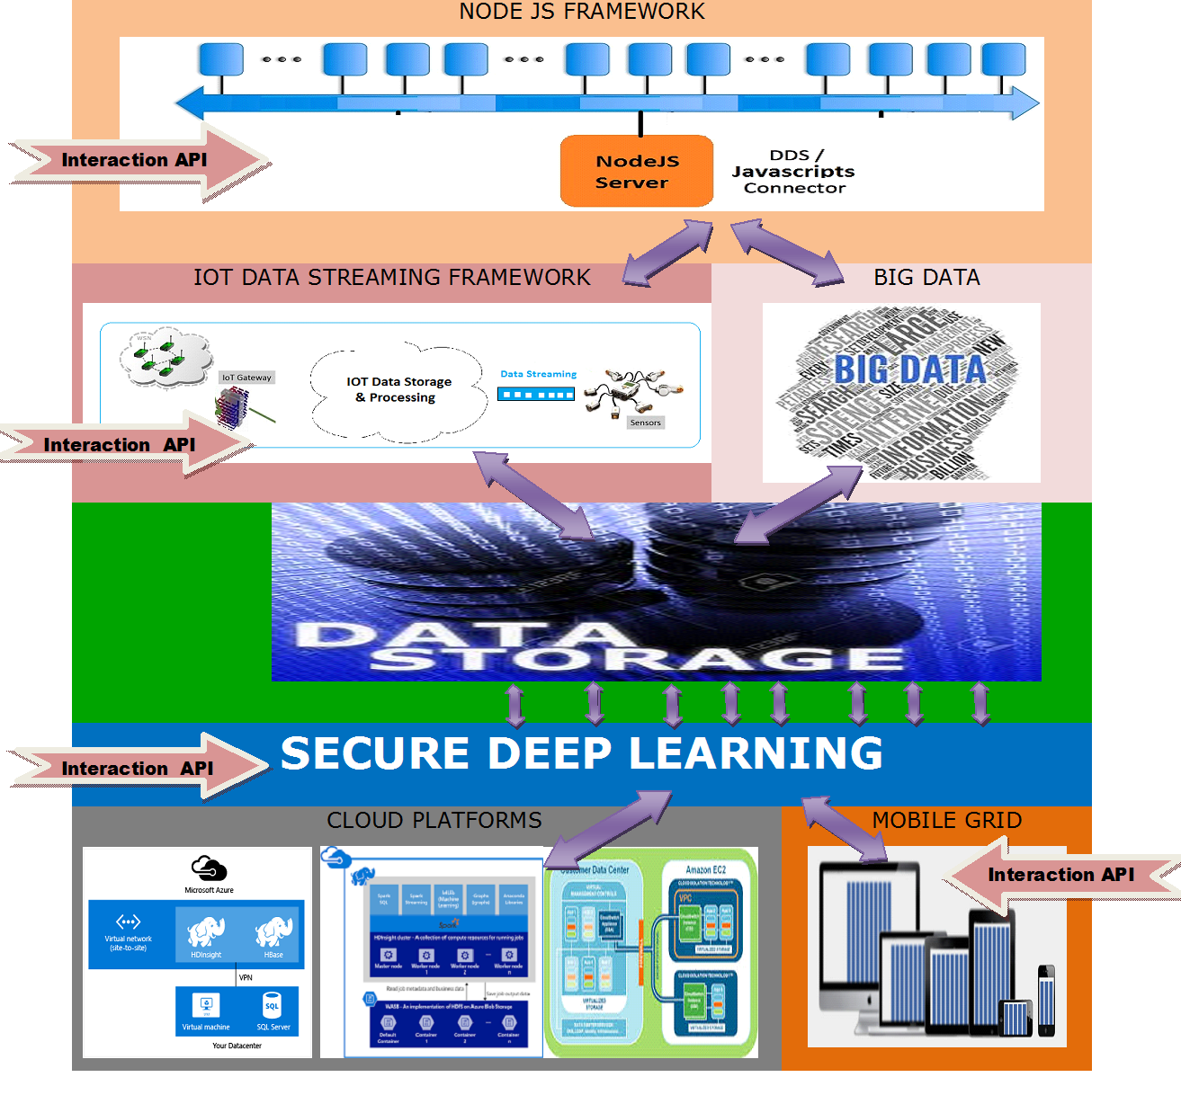
5. Research Methodology
Fig. 6 Research Methodology

Slide 15
6. Research Plan
March 2019
Review paper writing
Review on proposed techniques and math model of objective 1
September 2019
Review on proposed techniques and math model of objective 2
Dec 2019
Publish third paper on 2nd objective results (SCI)
2nd Review
March 2020
Review on proposed techniques and math model of objective 3
June 2020
Publish third paper on 2nd objective results (Transaction)
3nd Review
September 2020
Review on live platform hosting
Hosting and testing
Dec 2020
Start thesis writing
Dec 2021
4th Review
June 2021
Completion of thesis first version
5th Review
Submission of final thesis
Jan 2022
Defence
Propose objectives, 1st Review
June 2019
Implementation and writing chapter on objective 2
Implementation and writing chapter on objective 3
Implementation and writing chapter on objective 1
Table 2. Research Plan

Slide 16
CONCLUSION
After the literature review, we identified research gaps in FHE are large size of encrypted data, more noise in decryption, only addition and multiplication operations possible on homomorphic data. Also multi party data aggregation of learning in needed. All private machine learning algorithms may give fast performance on GPU systems with parallel algorithm.

Slide 17
References
[1] R. L. Rivest, L. Adleman, and M. L. Dertouzos, “On Data Banks and Privacy Homomorphism,” Found. Secur. Comput., vol. 4, no. 11, pp. 169–178, 1978.
[2] P. Paillier, “Public-{K}ey {C}ryptosystems {B}ased on {C}omposite {D}egree {R}esiduosity {C}lasses,” Eurocrypt, pp. 223–238, 1999.
[3] C. Gentry, “Computing arbitrary functions of encrypted data,” Commun. ACM, vol. 53, no. 3, p. 97, 2010.
[4] P. Sha and Z. Zhu, “The modification of RSA algorithm to adapt fully homomorphic encryption algorithm in cloud computing,” Proc. 2016 4th IEEE Int. Conf. Cloud Comput. Intell. Syst. CCIS 2016, no. 1, pp. 388–392, 2016.
[5] S. Kuri, T. Hayashi, T. Omori, and S. Ozawa, “Privacy Preserving Extreme Learning Machine Using Additively Homomorphic Encryption,” 2017.
[6] K. Rangasami and S. Vagdevi, “Comparative study of homomorphic encryption methods for secured data operations in cloud computing,” Int. Conf. Electr. Electron. Commun. Comput. Technol. Optim. Tech. ICEECCOT 2017, vol. 2018–Janua, pp. 551–556, 2018.
[7] S. Angra and S. Ahuja, “Machine learning and its applications: A review,” in Proceedings of the 2017 International Conference On Big Data Analytics and Computational Intelligence, ICBDACI 2017, 2017, pp. 57–60.
[8] M. R. Ogiela and M. Oczko, “Comparison of Selected Homomorphic Encryption Techniques,” 2018 IEEE 32nd Int. Conf. Adv. Inf. Netw. Appl., pp. 1110–1114, 2018.
[9] R. Bocu and C. Costache, “A homomorphic encryption-based system for securely managing personal health metrics data,” vol. 62, no. 1, pp. 1–10, 2018.
[10] W. Hua and A. R. Learning, “A Brief Review of Machine Learning and Its Application,” 2009 Int. Conf. Inf. Eng. Comput. Sci. Inf. Eng. Comput. Sci. 2009. ICIECS 2009. Int. Conf., p. 1, 2009.

Slide 18
References
[11] J. W. Bos, K. Lauter, and M. Naehrig, “Private predictive analysis on encrypted medical data,” J. Biomed. Inform., vol. 50, pp. 234–243, 2014.
[12] C. D. Ata, M. Bilenko, T. Finley, R. Gilad-bachrach, K. Lauter, and M. Naehrig, “Crypto-Nets: Neural Networks over Encrypted Data,” pp. 1–9, 2015.
[13] R. Shokri and V. Shmatikov, “Privacy-Preserving Deep Learning ∗,” pp. 909–910, 2015.
[14] R. Vinayakumar, S. Kp, and P. Poornachandran, “Deep Encrypted Text Categorization,” pp. 364–370, 2017.
[15] L. J. Helsloot, G. Tillem, and Z. Erkin, “AHEad : Privacy-preserving Online Behavioural Advertising using Homomorphic Encryption,” pp. 4–7, 2017.
[16] R. Talbi, S. Bouchenak, and L. Y. Chen, “Towards Dynamic End-to-End Privacy Preserving Data Classification,” 2018 48th Annu. IEEE/IFIP Int. Conf. Dependable Syst. Networks Work., pp. 73–74, 2018.
[17] X. Sun, P. Zhang, J. K. Liu, J. Yu, and W. Xie, “Private machine learning classification based on fully homomorphic encryption,” vol. 6750, no. c, 2018.
[18] L. J. M. Aslett, P. M. Esperança, and C. C. Holmes, “A review of homomorphic encryption and software tools for encrypted statistical machine learning,” pp. 1–21, 2015.
[19] L. I. Mengting and L. I. U. Jun, “Deep Hashing for Large-scale Image Retrieval,” no. 2, pp. 10940–10944, 2017.

